Slide 1
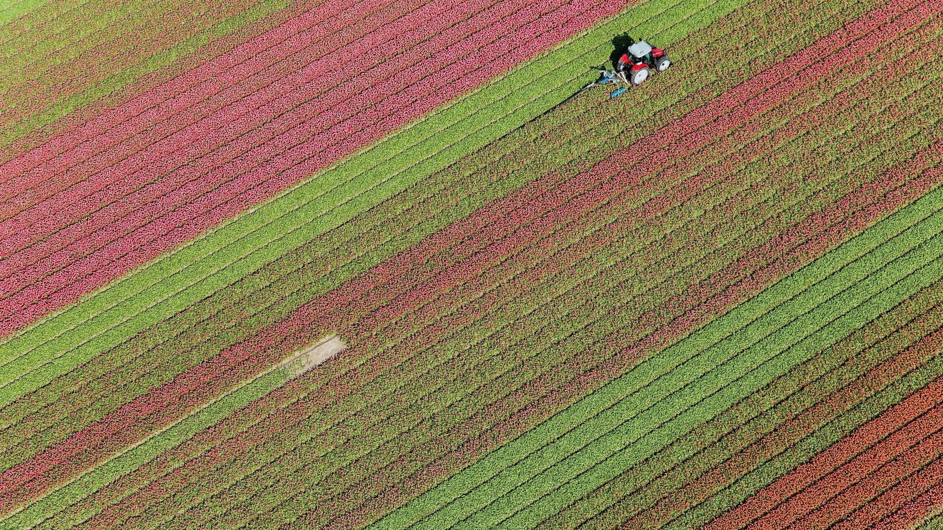

Swarm Robotics ABM Simulation in Agriculture
Project Proposal
Team: Bethlehem B. Bethun B. Tousif S.

Slide 2
Agenda
Project Summary
Background
Context and Importance
Existing Work
Project Timeline
High-level timelines
Target vs Stretch Goals
Division of Labour
Technologies / Methods
Python - MESA
Machine Learning/ Deep Learning
References
Appendix

Slide 3
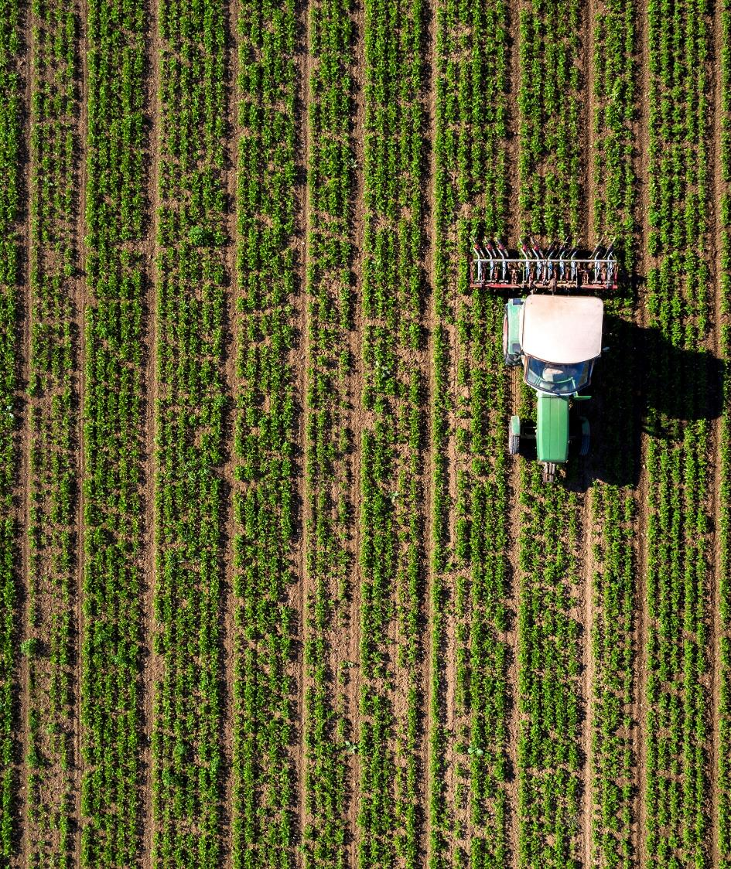
Project Summary We aim to build simulation algorithms of Swarm Robotics by leveraging ground robots and drones in an Agent-Based Model to improve yield optimization.
The algorithms will focus on:
efficiency and effectiveness in communication between the drones and ground robots
path planning, optimization, and coordination
weed detection and plant disease identification
The project will explore scenarios with ground-only swarm robots and a combination of ground and aerial vehicles, using the Python MESA framework for agent-based modeling (ABM).

Slide 4
Background

Slide 5
Context and Importance
The project aims to simulate and evaluate the performance of swarm robotics algorithms in agricultural environments.
Context:
Swarm robotics in agriculture would be used to maximize crop yields through precision farming
The collective behavior of multiple ground robots and drones will be leveraged. By enabling communication between them, tasks can be executed faster and adaptively.
Objectives and Importance:
Assess the efficiency and effectiveness of robot communication, path planning, optimization, and coordination.
Explore the integration of ground and aerial swarm robots for enhanced agricultural operations.
Solve for weed detection and plant disease identification as use cases by integration into Agent Based Modeling (ABM)
The market size of robotics in agriculture is $15 Billion (2022) and projected at $40 Billion by 2028.
Our project has real world applications for advancement of automating farming practices, optimizing resources, and reducing the environmental footprint of agricultural activities.

Slide 6
Existing Work
Literature Review Summary:
Our literature review covers articles and research papers that focus on the application of swarm robotics and artificial intelligence in agriculture:
Challenges of integrating swarm robotics into mechanized agricultural operations, emphasizing the need for research in this field (Albiero et al, 2022)
Overview of reinforcement learning applications in swarm robotics (​Akhloufi and Blais, 2023) ​​.
Multi-agent path planning for robotic swarms in agricultural fields (Botteghi et al. 2020)
Agent-based approaches and review simulators, platforms, and applications of swarm robotics, respectively, showcasing the potential of cooperative swarm robotics in agriculture (Bunte (2021) and Calderón-Arce et al. (2022)) ​​​​
Data Set Overview:
The dataset review encompasses a variety of resources aimed at advancing agricultural technologies through image analysis and machine learning.
Olsen's DeepWeeds dataset provides images for multiple weed species, facilitating the development of deep learning models for weed identification​
Dataset for date fruit to facilitate research in intelligent harvesting, (Altaheri et al. 2019)
The cwfid dataset offers a comprehensive crop/weed field image collection, designed for distinguishing between crops and weeds​​.
Menber's GitHub repository presents a dataset coupled with a convolutional neural network (CNN) approach for detecting anomalies in crops
Note: Please refer to Appendix for detailed Literature and Data Set References

Slide 7
Business use cases for the project
We identified several use cases that can be achieved via swarm robotics
Potential business use cases:
Optimal application of fertilizers
Optimal application of pesticides
Accurate weed removal and control
Disease identification in crops
Fruit identification to determine ripeness
Monitoring crops over vast farmland
Improving overall agricultural efficiency
Project scope for business applications:
Weed detection in crops
Disease identification in crops
The scope of our project may be refined further or tweaked based on challenges related to range of the swarm robots among themselves and with the drones, path optimization challenges and nature of datasets available

Slide 8
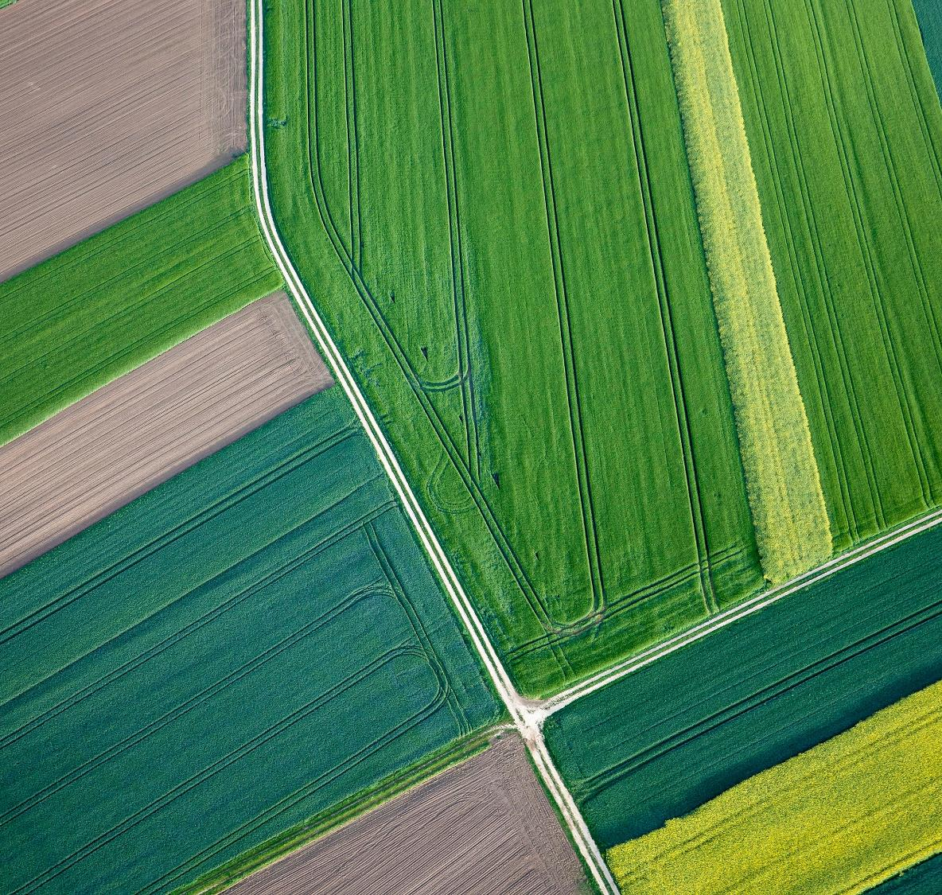
Project Timeline

Slide 9
Project Timeline
Week 1
Week 2
Week 3
Week 4
Week 5
Week 6
Week 7
Week 8
Week 9
Project Planning
M0: Detailed Task Plan
Literature Analysis
M1: Background Work
Python MESA Setup
M2: Basic ABM
Basic ABM – Ground Robots
Implement Optimization of path
M3: Use case(s) algorithm Finalization
Coordination and Communication Algo
M4: Aerial + Ground ABM
Extend Simulation – Aerial Vehicles
M5: Testing Completion
Testing and Analysis
M6: Presentation
Preparation of Presentation
M - Milestone

Slide 10

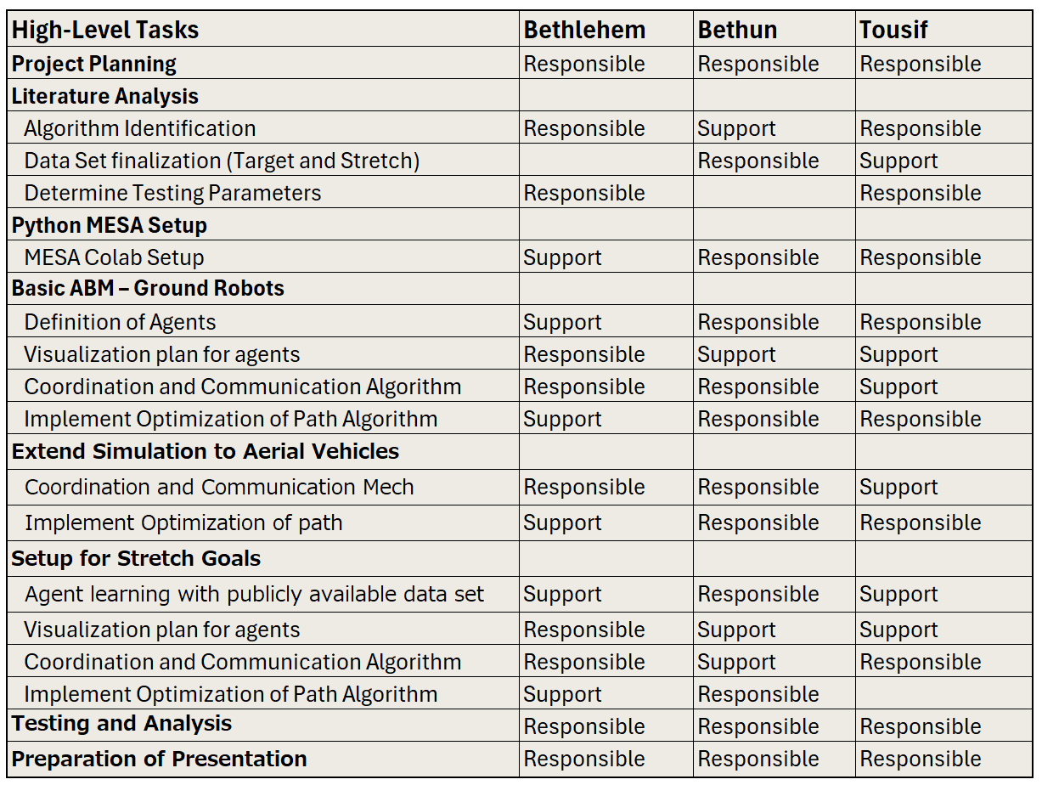


Individual Roles and Responsibilities
Bethlehem B.
Bethun B.
Tousif S.

Slide 11
Target vs Stretch Goals
Target Goal
Explore coordination in the ground robots and drones for successful weed & disease detection on datasets of soybean plants
Successfully simulate communication and basic path planning for ground swarm robots to explore algorithm such as Nearest Neighbour based on K-means clustering, Christofides, Ant Colony Optimisation and Bellman-Held-Karp
Enable coordination between the ground robots and aerial drones for defined use cases
Stretch Goal
Implement advanced coordination strategies, including rescue operations for stuck robots, and integrate aerial vehicles into the simulation for complex tasks
Train agents to detect weed and diseased plants in soya beans using tools such as TensorFlow and integrate with the ABM for testing and analysis
Proposed Process Flow:
Weed/ Disease Identification
Flag created by a robot
The robot communicates with the Swarm
Swarm navigation to flagged location
Resolution tasks performed
Communication signal to stakeholders

Slide 12

Technologies / Methods

Slide 13
Python MESA
Overview: Python MESA will be the framework for implementing our ABM simulations, enabling us to model complex interactions between swarm robots and their environment. MESA offers flexibility in defining agent behaviors, interactions, and the simulation environment, which is crucial for our project’s needs.
Python MESA for Target Goal
Features Utilized: We will leverage MESA's capabilities to define complex agent behaviors, inter-agent interactions, and environmental dynamics. This includes utilizing the scheduling functions to control the order of agent actions, the space module to define the physical or abstract space in which agents operate, and the data collection features to track and analyze the state of the simulation over time.
Benefits: MESA's open-source nature and active community support make it a robust and flexible choice for ABM development. Its integration with the broader Python ecosystem allows for the extension of simulations with custom behaviors and analysis tools.
Data Analysis with Pandas and NumPy : Pandas and NumPy provide a comprehensive toolkit for data analysis, from basic descriptive statistics to complex data transformations. Their integration with Python and MESA ensures a seamless workflow from simulation to analysis

Slide 14
Machine learning/ Deep Learning
Objective: Enhance the capabilities of both ground and aerial robotic agents within our ABM by incorporating Machine learning/ Deep Learning models trained on datasets of soybean plants for weed detection and autonomously identifying diseased plants to facilitate targeted interventions and contributing to the overall health and yield of crops
Computer Vision for Stretch Goal
Features Utilized: Explore using TensorFlow, scikit-learn, scikit-image, and Keras for efficient development of models for weed detection and plant disease identification. We will also explore methods for integrating Python-based machine learning models with MESA, such as using serialized model formats (e.g., ONNX) for easier embedding within the simulation environment.
Benefits: These libraries provide tools for deep learning, machine learning, and image processing, and they can help in streamlining tasks such as data preprocessing, feature extraction, and model training.
Data Analysis: Continue to use Pandas and NumPy for analyzing simulation outcomes.

Slide 15
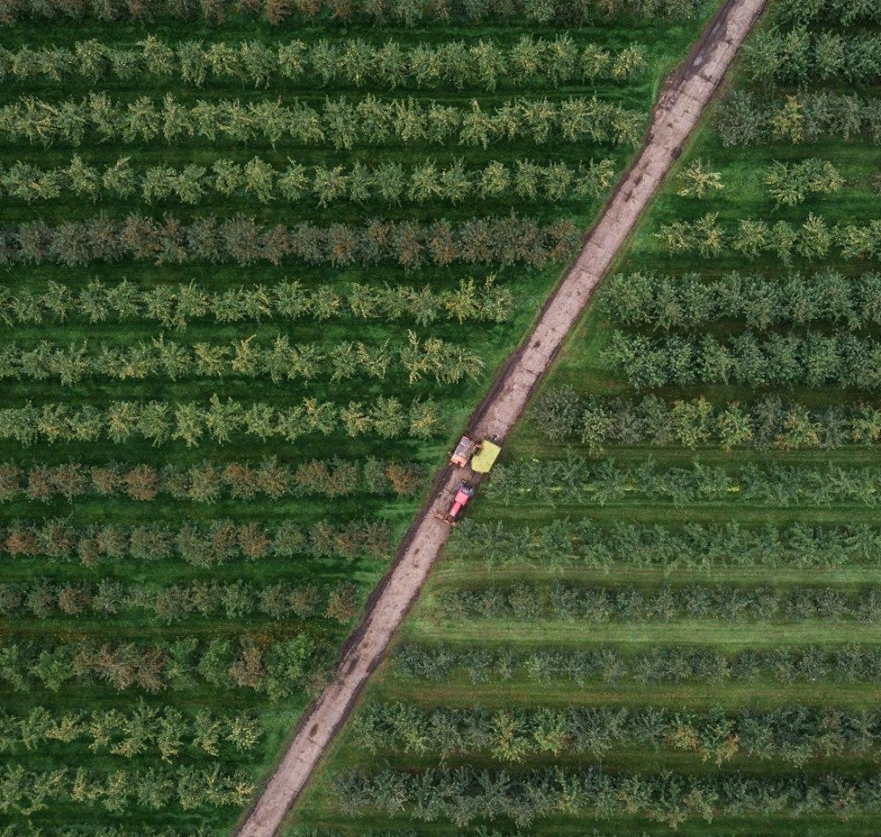
References

Slide 16
Appendix
Literature Review
Albiero, D., Garcia, A., Umezu, C., & Paulo, R. (2022). Swarm robots in Mechanized Agricultural Operations: A review about challenges for research. Computers and Electronics in Agriculture. https://www.sciencedirect.com/science/article/abs/pii/S0168169921006256
Akhloufi, M., & Blais, M. (2023). Reinforcement learning for swarm robotics: An overview of applications, algorithms and simulators. Cognitive Robotics. https://www.sciencedirect.com/science/article/pii/S2667241323000241
Botteghi, N.. & Kamilaris, A., Sinai, L. & Sirmacek, B. (2020). Multi-Agent Path Planning of Robotic Swarms in Agricultural Fields. Annals of Photogrammetry, Remote Sensing and Spatial Information Sciences. V-1-2020. 361-368. 10.5194/isprs-annals-V-1-2020-361-2020.
Bunte, S. (2021). Introducing cooperativeness for agrobotics : An agent-based approach. https://essay.utwente.nl/88141/1/Bunte_MA_BMS.pdf
Calderón-Arce C, Brenes-Torres JC, Solis-Ortega R. Swarm Robotics: Simulators, Platforms and Applications Review. Computation. 2022; 10(6):80. https://doi.org/10.3390/computation10060080
Carbone, C., Garibaldi, O., & Kurt, Z. (2018). Swarm Robotics as a Solution to Crops Inspection for Precision Agriculture. KnE Engineering, 3(2), 552-562. https://doi.org/10.18502/keg.v3i1.1459
Din, A., Ismail, M., Shah, B., Babar, M., Ali, F., & Baig, S. (2022). A deep reinforcement learning-based multi-agent area coverage control for Smart Agriculture. Computers and Electrical Engineering. https://www.sciencedirect.com/science/article/abs/pii/S0045790622003445
Kiani F, Seyyedabbasi A, Nematzadeh S, Candan F, Çevik T, Anka FA, Randazzo G, Lanza S, Muzirafuti A. (2022). Adaptive Metaheuristic-Based Methods for Autonomous Robot Path Planning: Sustainable Agricultural Applications. Applied Sciences. https://doi.org/10.3390/app12030943
Kuhlmann, S. (2021). Adaptive swarm robotics could revolutionize smart agriculture. Texas A&M Today. https://today.tamu.edu/2021/11/15/adaptive-swarm-robotics-could-revolutionize-smart-agriculture/
Olaronke, I., Rhoda, I., Gambo, I., Oluwaseun, O., & Janet, O. (2020). A Systematic Review of Swarm Robots. Current Journal of Applied Science and Technology, 39(15), 79–97. https://doi.org/10.9734/cjast/2020/v39i1530719
Rosenberger, C., Arguenon, V., & Bergues-Lagarde, A. (2006). Multi-agent based prototyping of Agriculture Robots. International Symposium on Collaborative Technologies and Systems (CTS’06). https://www.academia.edu/55634151/Multi_Agent_Based_Prototyping_of_Agriculture_Robots
Tian, H., Wang, T., Liu, Y., Quiao, X., & Li, Y. (2019, September 27). Computer Vision Technology in Agricultural Automation -A Review. Information Processing in Agriculture. https://www.sciencedirect.com/science/article/pii/S2214317319301751#b0175
Saga - Swarm Robotics for agricultural applications. (2019. The European Coordination Hub for Open Robotics Development. https://echord.eu/saga.html

Slide 17
Appendix
Data sets
Altaheri, H., Alsulaiman, M., Muhammad, G., Amin, S., Bencherif, M., & Mekhtiche, M. (2019, September 18). Date fruit dataset for intelligent harvesting. Data in Brief. https://www.sciencedirect.com/science/article/pii/S2352340919308698?via%3Dihub
Haug, S. cwfid/dataset: A Crop/Weed Field Image Dataset. GitHub. https://github.com/cwfid/dataset
Menber, J. josemenber/image-based-crop-anomaly-detection: A Convolutional Neural Network approach for image-based anomaly detection in smart agriculture. GitHub. https://github.com/josemenber/image-based-crop-anomaly-detection
Olsen, A. Alexolsen/deepweeds: A multiclass weed species image dataset for deep learning. GitHub. https://github.com/AlexOlsen/DeepWeeds
Plant_disease_resnet50. Kaggle. https://www.kaggle.com/code/aryanml007/plant-disease-resnet50/notebook
Rice Classification ~99.2% Accuracy. Kaggle. https://www.kaggle.com/code/mushfirat/rice-classification-99-2-accuracy/comments
Sa, I. (2019). DeepFruits_dataset. Google Drive. https://drive.google.com/drive/folders/1CmsZb1caggLRN7ANfika8WuPiywo4mBb
Weed detection in soybean crops. Kaggle. (2018, September 12). https://www.kaggle.com/datasets/fpeccia/weed-detection-in-soybean-crops

Slide 18
Thank You

